Slide 1

STAT1000J Spring 2025
Data Science for Future Engineers
Unraveling the Influence of Social Media on Students
Group 9
Zhuoyang Xie Chenkai Ji
Both of the group members contributed to
every part of the project.

Slide 2

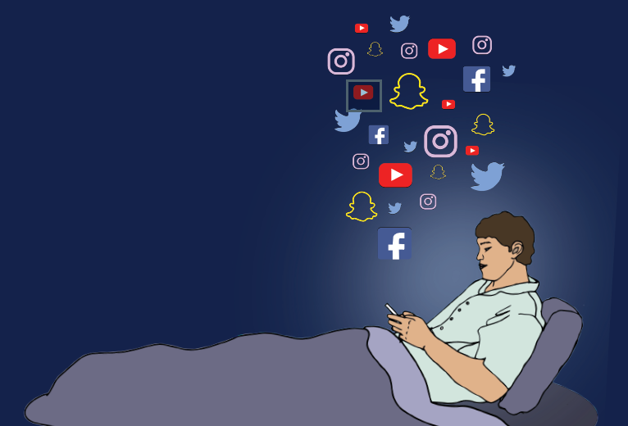
Contents
01. Motivation
02. Goals
03. Basic Information
04. Data exploration
05. Hypothesis testing
06. Predictive model
07. Conclusion
Notes:
单击此处添加文本

Slide 3
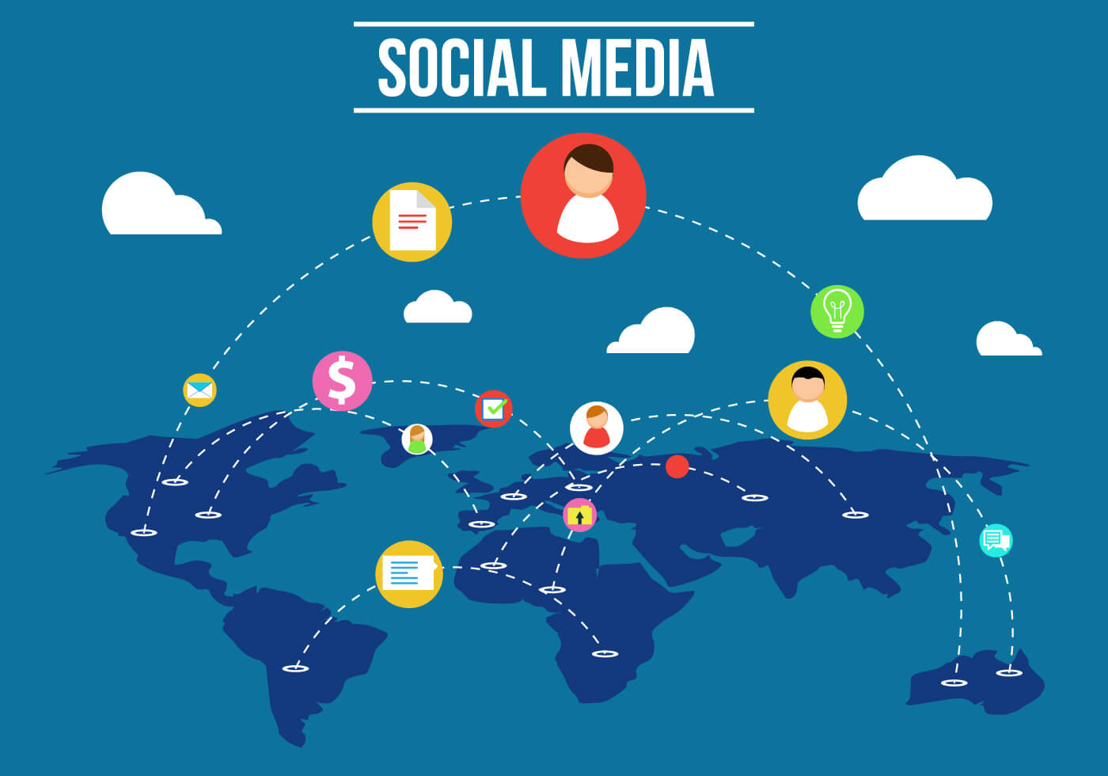
Motivation
Massive Social Media Usage
What influence does social media brings nowadays?
How is it related to soical media addition?
Notes:
单击此处添加文本

Slide 4
Goals
Overview some basic information about the dataset.
Explore the data to find interesting correlations.
Use hypothesis testing for proposed relationships.
Create a predictive model on social media addiction.
Notes:
单击此处添加文本

Slide 5
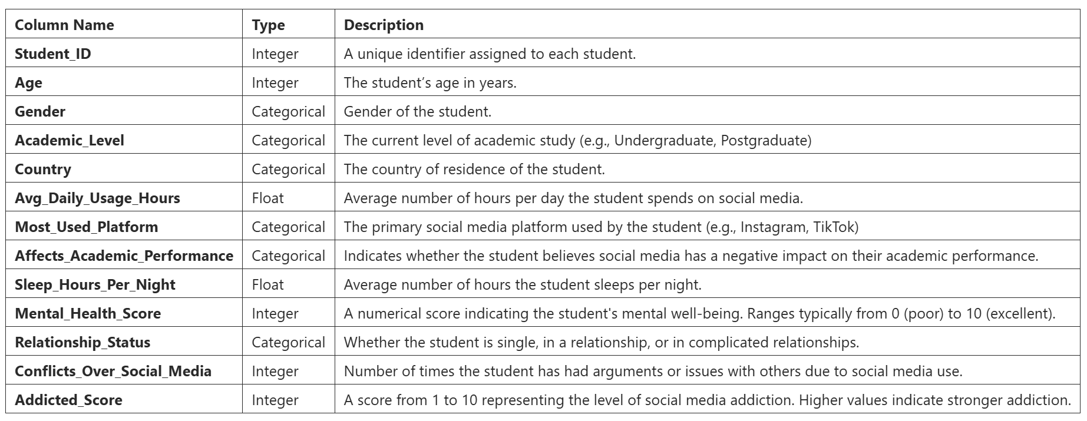
Basic Information
data=pd.read_csv('Students Social Media Addiction.csv') 705 rows × 13 columns
Notes:
单击此处添加文本

Slide 6

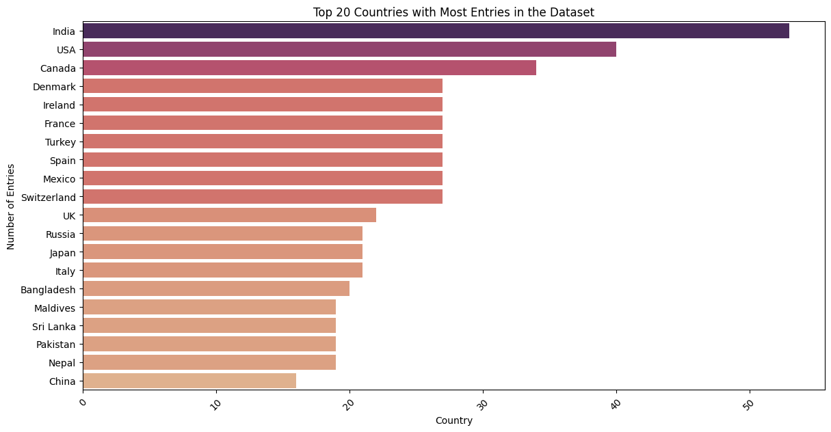
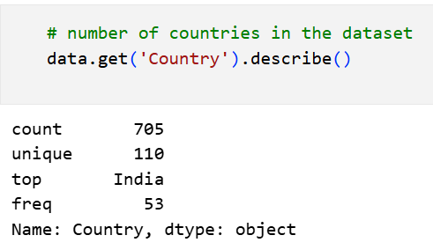
Basic Information
Is this dataset universally applicable or only applicable for a certain region/gender/etc?
Notes:
单击此处添加文本

Slide 7
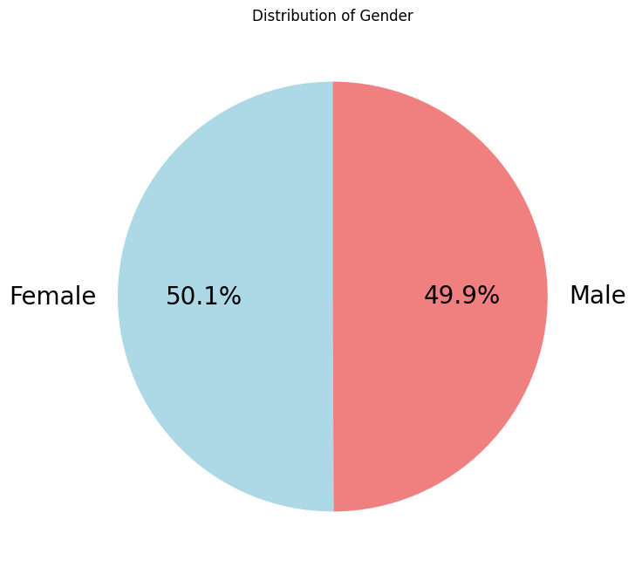
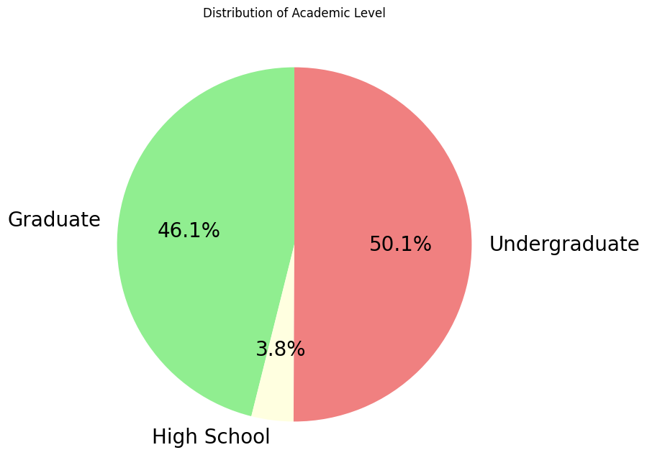
Basic Information
Notes:
单击此处添加文本

Slide 8
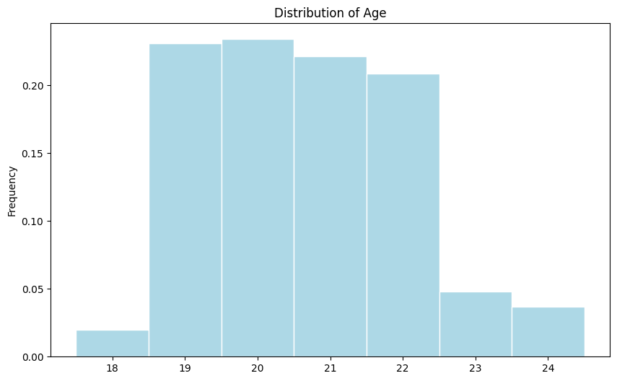
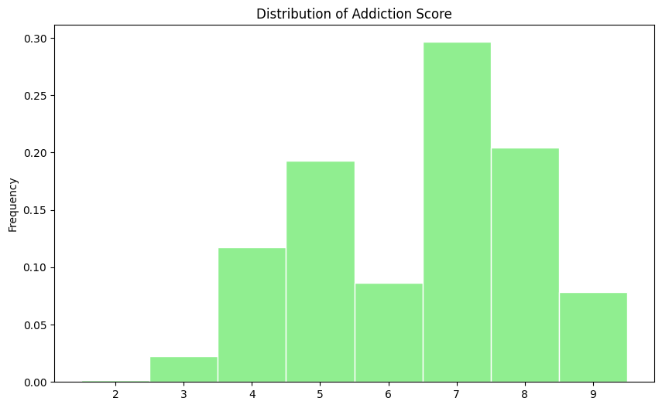
Basic Information
Notes:
单击此处添加文本

Slide 9
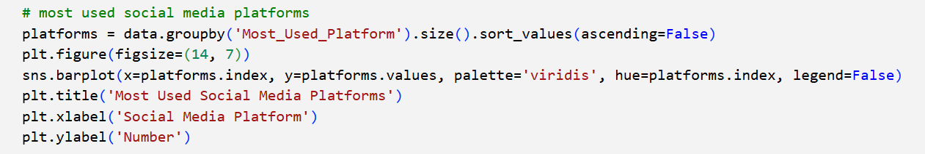
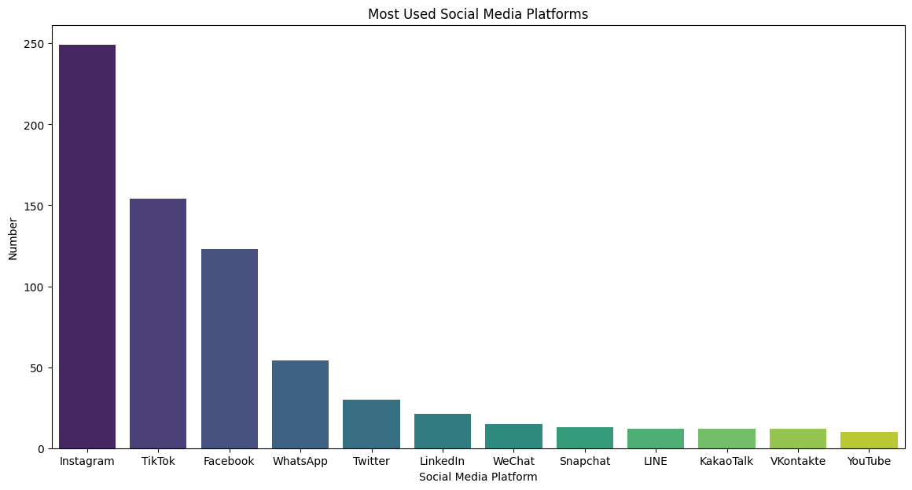


Data Exploration (Groupby)
Dominantly!
viral of short video platform?
Followed by
Notes:
单击此处添加文本

Slide 10
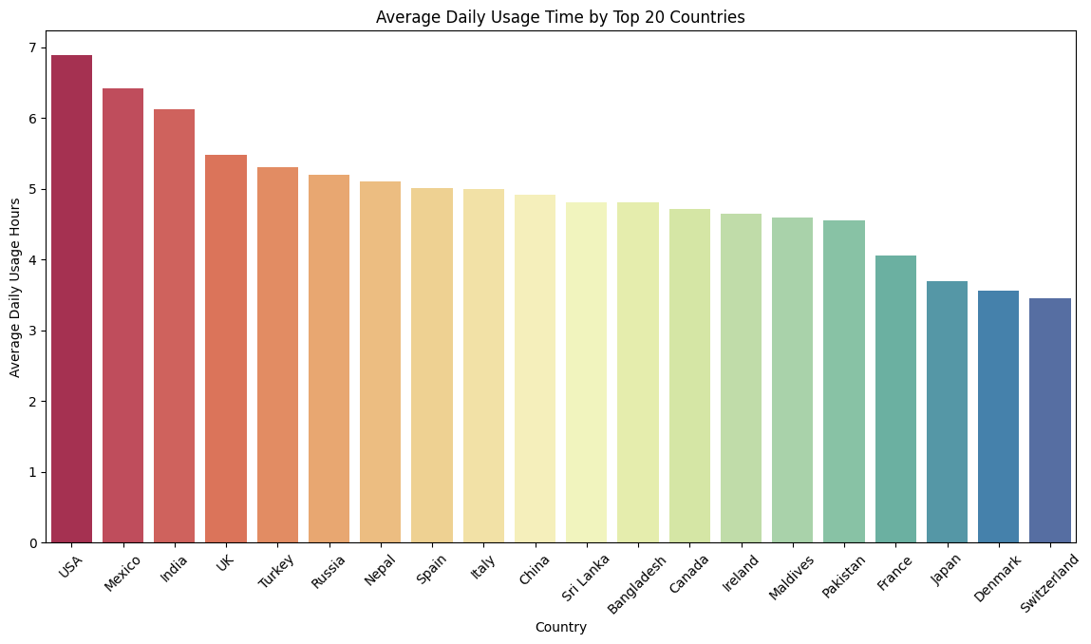

Data exploration (Groupby)
TOP 5 Countries
USA
Mexico
UK
Turkey
Russia
Notes:
单击此处添加文本

Slide 11
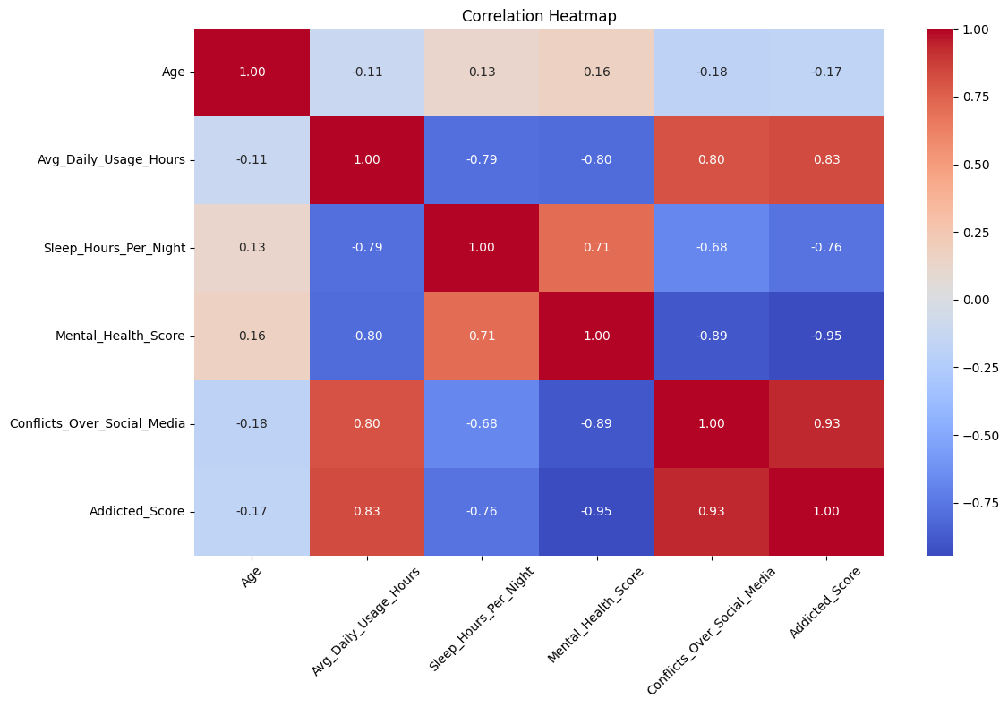
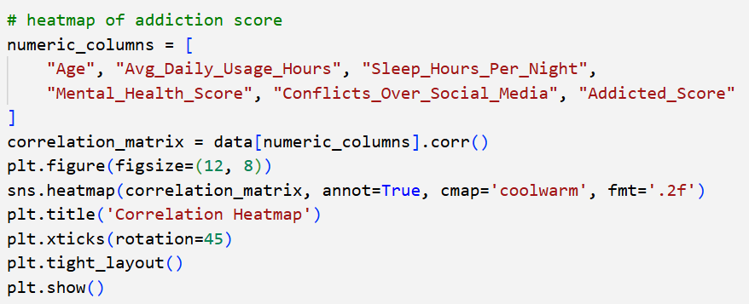
Data exploration (Heat Map)
We notice a strong negative correlation
Sleep Hours vs.Average Daily Usage Hours.
Mental Health vs. Average Daily Usage Hours.
Plot the graphs to check them out!

Slide 12
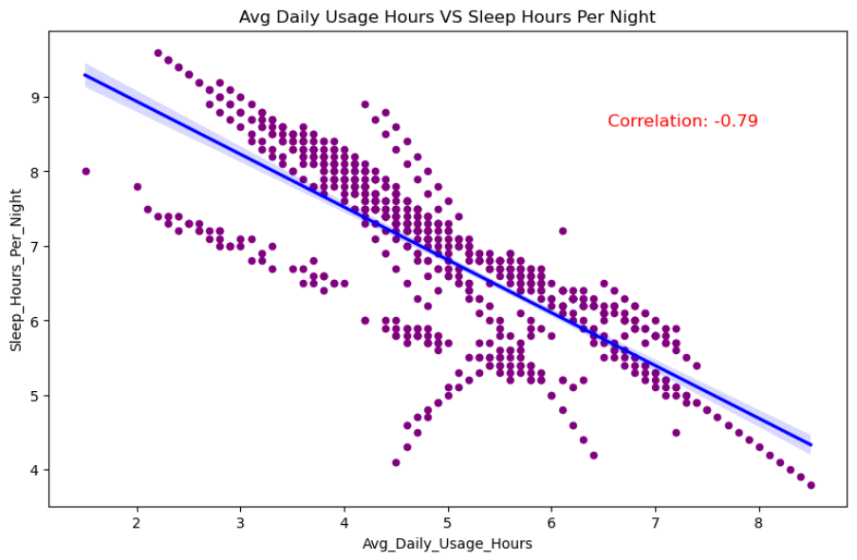
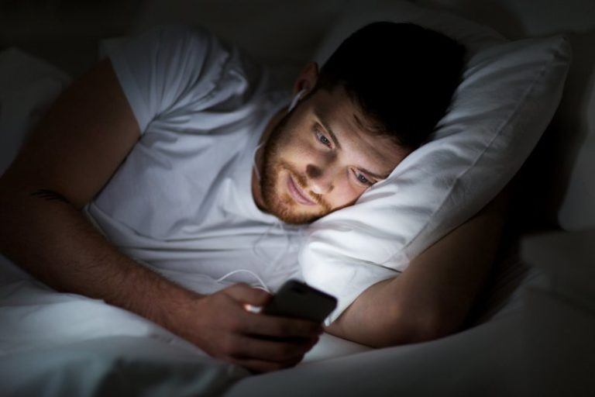
Data exploration (Scatter and Regressioion)
significant negative influence!
Notes:
单击此处添加文本

Slide 13
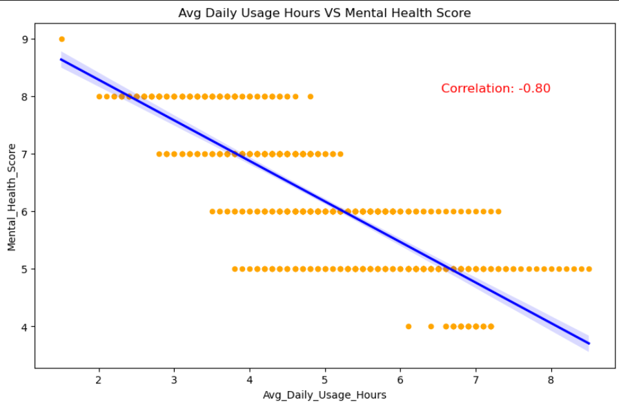

Data exploration (Scatter and Regressioion)
significant negative influence!
Notes:
单击此处添加文本

Slide 14
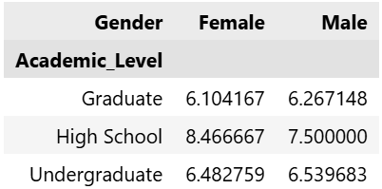

Data exploration (Pivot Table)
Pivot Table: Average Addiction Score by Academic Level and Gender:
high school students are more susceptible to social media, with girls addiction score slightly higher

Slide 15
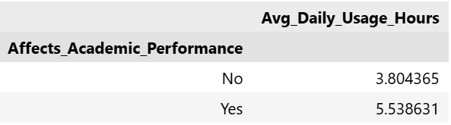
Hypothesis testing
Academic Performance and Usage Hours (Permutation)
Null Hypothesis:
There is no difference between the two groups in terms of average social media usage hours.
- In other words, the difference we saw was due to random chance.
Alternative Hypothesis:
There is a significant difference in average social media usage between two groups
- In other words, what we saw cannot be explained by random chance alone, and there is instead a meaningful difference in these distributions.
Test Statistics:
Average Mean difference=5.53-3.80= 1.73

Slide 16
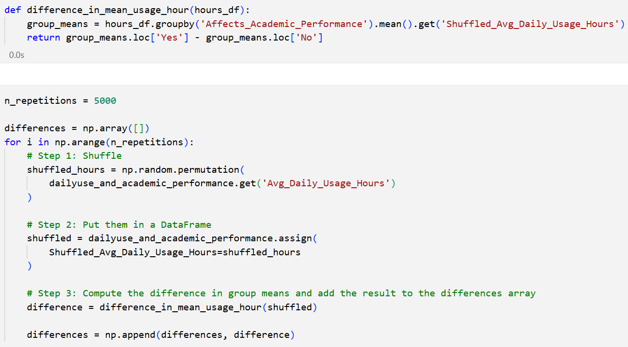
Hypothesis testing
Simulation
On each iteration:
1. Shuffle the average daily social media usage hour.
2. Put them in a DataFrame.
3. Compute the difference in group means.

Slide 17
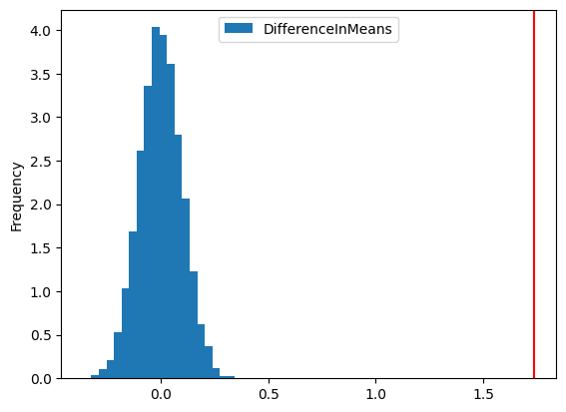
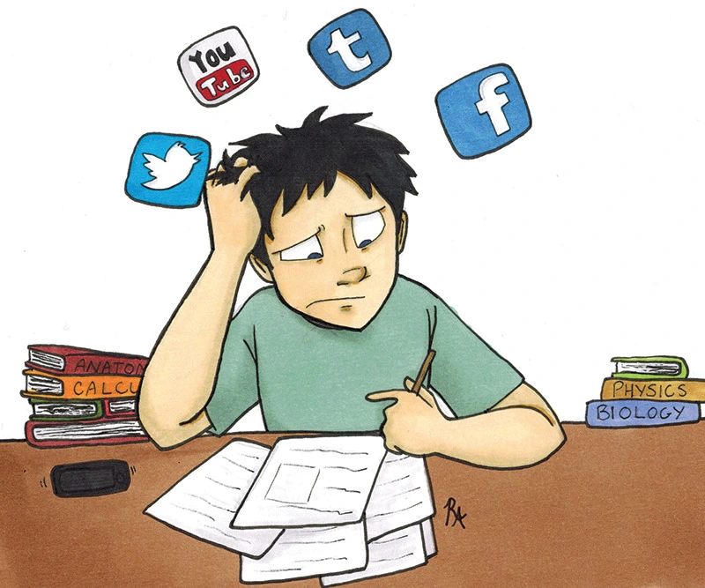
Hypothesis testing
Under the null hypothesis, we rarely see differences as large as this.
Therefore, we reject the null hypothesis: the two groups do not come from the same distribution.
That is to say, there may be meaningful relationship between average daily social media usage time and academic performance.

Slide 18
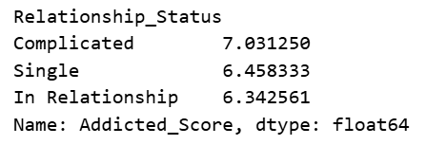
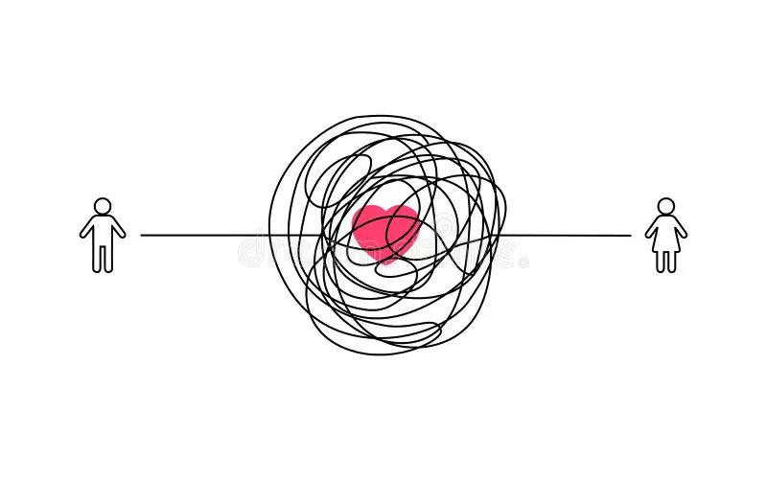
Hypothesis testing
Relationship and Addiction Score
high addicted score !
one category for further analysis Simple.
H_0: There is no significant difference in the addicted score between students in complicated relationships and those in simple relationships.
H_1: There is a significant increase in the addicted score for students in complicated relationships than those in simple relationships.
similar

Slide 19
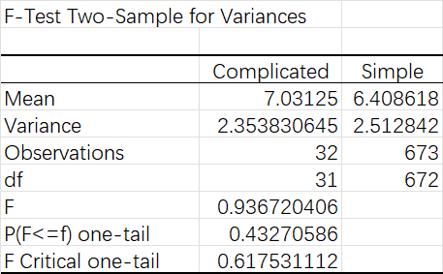
Hypothesis testing
1. F-test to compare the variances of the addicted scores between the two groups (Complicated vs. Simple).
H_0: The variances of the addicted scores in both groups are equal.
H_1: The variances of the addicted scores in both groups are not equal.
This suggests that there is no significant difference in Variance of the addicted score between students in complicated relationships and those in simple relationships.
significantly higher than signifiance level(0.05)

Slide 20
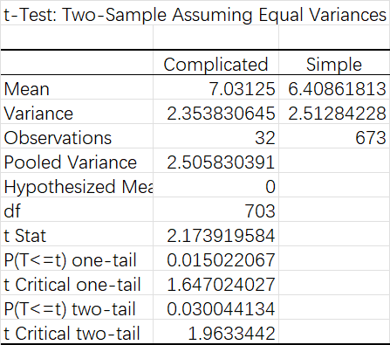
Hypothesis testing
Since the samples are relatively large ( >30 ), according to Central Limit Theorm, the distribution is close to nomral distribution.
Therefore we use t-Test: Two-Sample Assuming Equal Variances to compare the means of the addicted scores between the two groups (Complicated vs. Simple).
This suggests that there is a significant increase in the addicted score for students in complicated relationships than those in simple relationships.
lower than signifiance level(0.05) ,reject H_0!

Slide 21
Predictive Model
We hope to predict Addicted Score
Recall the heatmap, many variables are highly correlated to each other ( |corr| > 0.7 ).
To reduce multicollinearity, we choose 'Conflicts Over Social Media' and 'Sleep Hours Per Night' as X variables, as they are highly correlated to 'Addicted Score' but less correlated to each other.

Slide 22
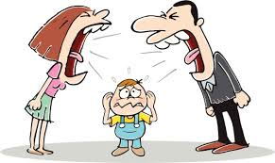
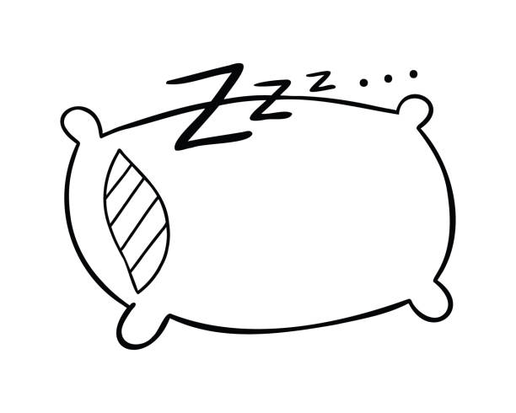
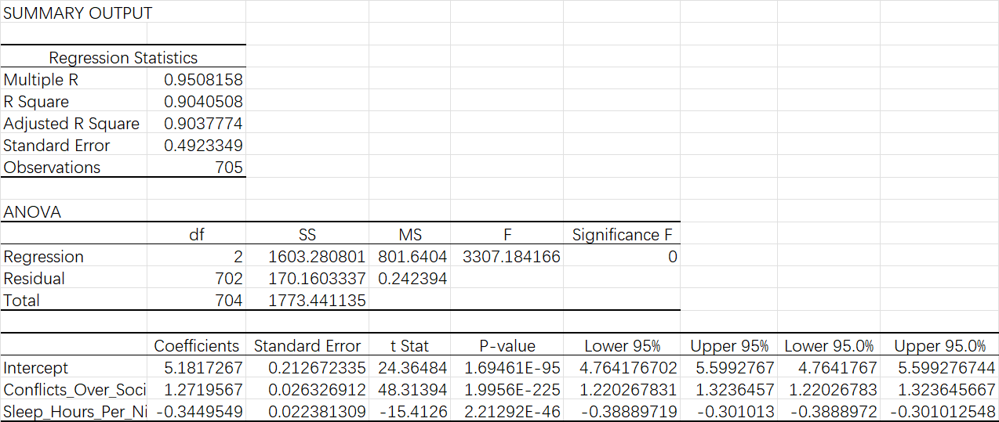
Predictive Model
AddictedScore = 1.272 (ConflictsOverSocialMedia) -0.345 * (SleepHoursPerNight) + 5.182
Notes:
单击此处添加文本

Slide 23
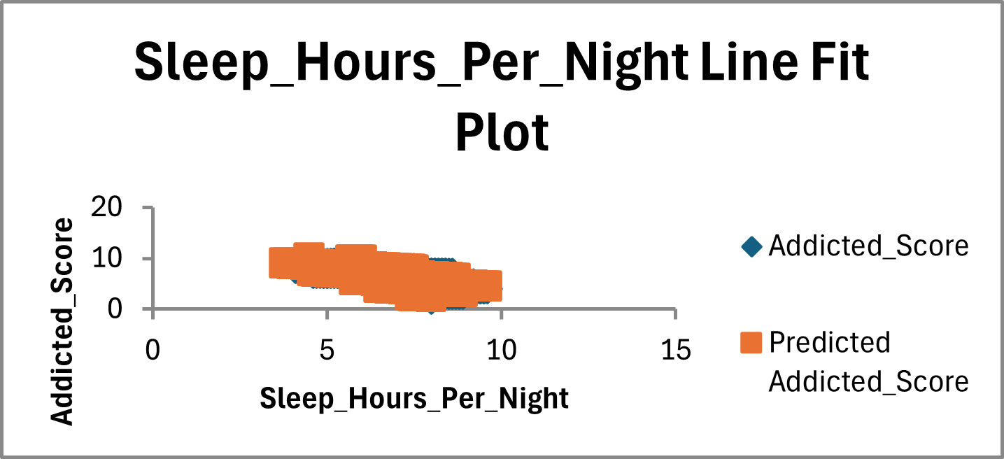
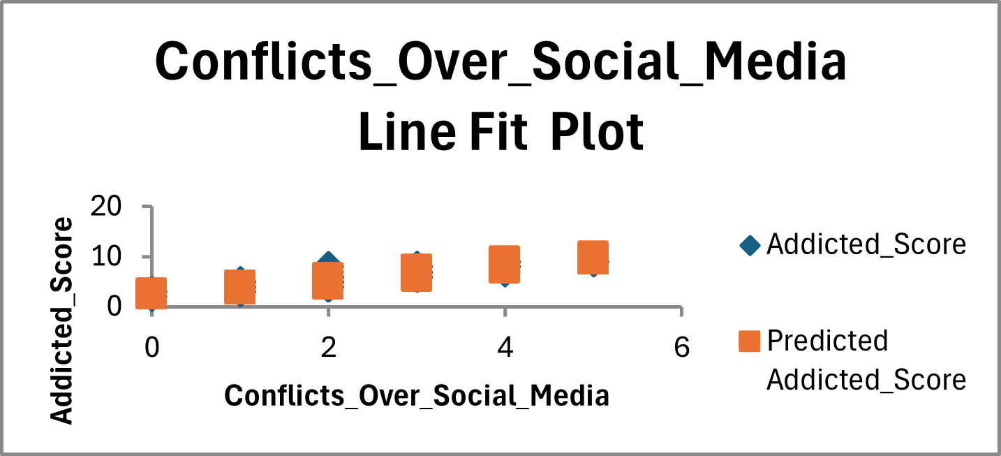
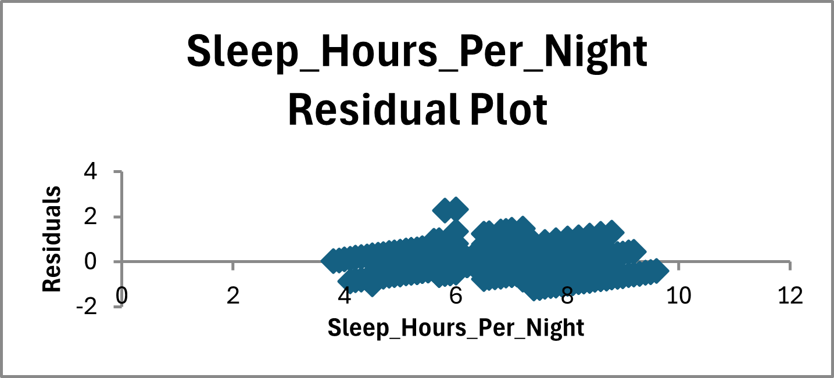
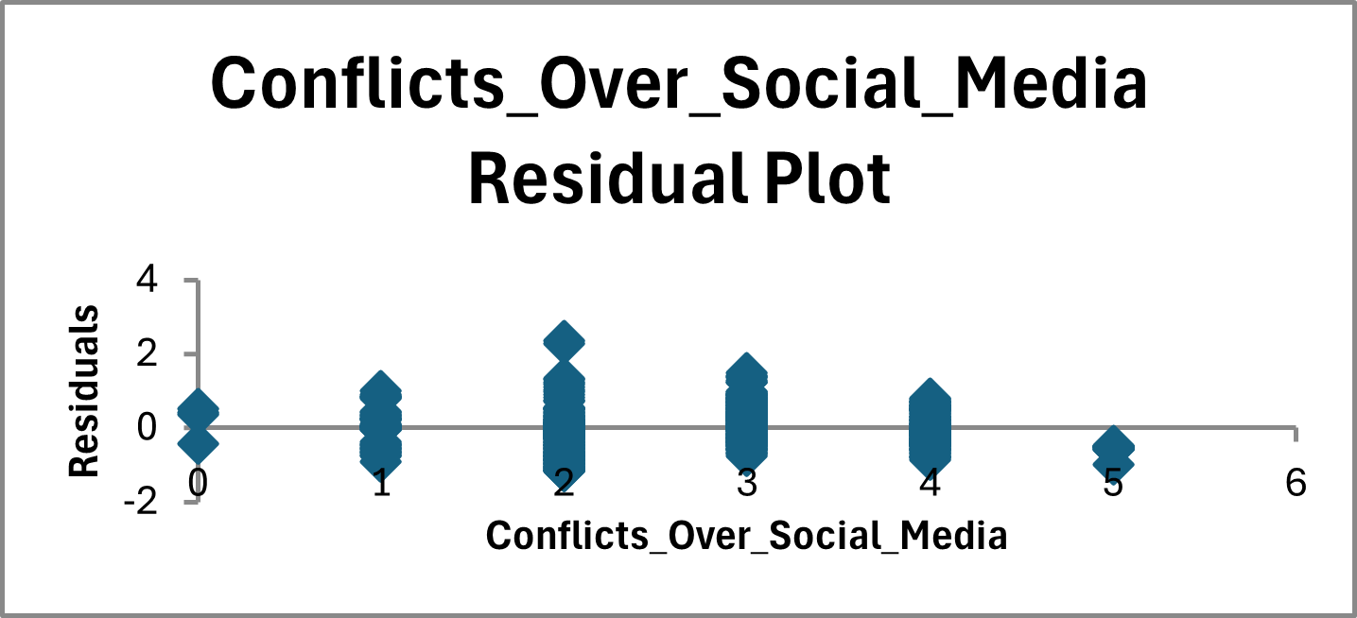
Predictive Model
AddictedScore = 1.272 (ConflictsOverSocialMedia) -0.345 * (SleepHoursPerNight) + 5.182
No outliers
No high leverage point
Residuals within +/- 3 std

Slide 24
Conclusion
Instagram is the most popular social media. USA students have the longest usage hours.
Addiction to social media is negatively correlated to Sleep Hours and Mental Health.
Long usage hours tend to lower academic performance. Addiction to social media is in line with poor interpersonal relationships.
Addicted Score can be predicted with Conflicts and Sleep Hours.

Slide 25
Conclusion
Suggestions:
If you have problems with sleep/ stress/ grades/ relationships:
Try control your time spent on Social Media.

Slide 26
References
https://www.kaggle.com/datasets/adilshamim8/social-media-addiction-vs-relationships

Slide 27
For Your Sleep For Your Health
For Your Grade For Your Girlfriend/Boyfriend
Keep Your Real-life Connections Strong！
Thanks for listening!

